Slide 1
International Schemes Application Tips
October 2020

Slide 2
Presenters
Paul Mal
Grants Information Officer
Alexina Weekes
Senior Grants Adviser – Infection and Immuno-Biology

Slide 3
Agenda
General Tips
International Masters Fellowship
International Training Fellowship

Slide 4
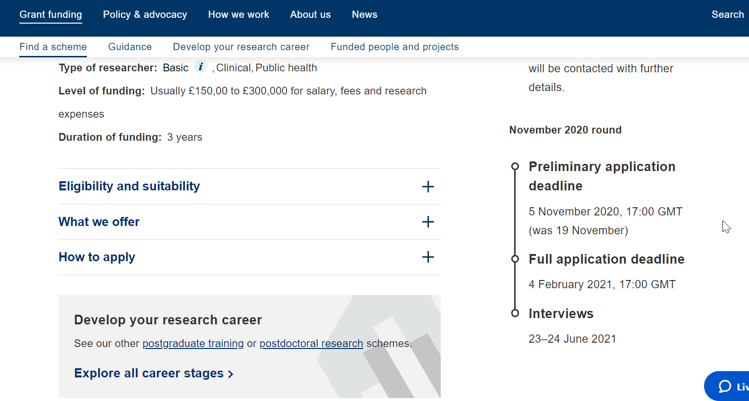
General Tips
The Training Fellowship & Intermediate Fellowship require a preliminary application be submitted before a full application
Notes:
For the Training and Intermediate Fellowships a preliminary application is required. This is to assess the eligibility of the project. These applications are sent directly to Wellcome for review.

Slide 5
General Tips
If your preliminary application is successful the applicant will be invited to submit a Full application
Notes:
If the preliminary application is successful the applicant will be invited to submit a full application. For these fellowships you can not submit a full application without first submitting a successful preliminary application.

Slide 6
General Tips
Once a Full application is submitted it goes to the Administering Organisation’s Authorised Organisational Approver (AOA)
If the organisation does not have an AOA, the applicant will be prompted to provide information to set one up in the application
Notes:
The full application will then go to the host organisation’s Authorised Organisational Approver, or AOA, to approve the application. If the applicant enters the host organisation name in the application and it does not have an AOA….

Slide 7
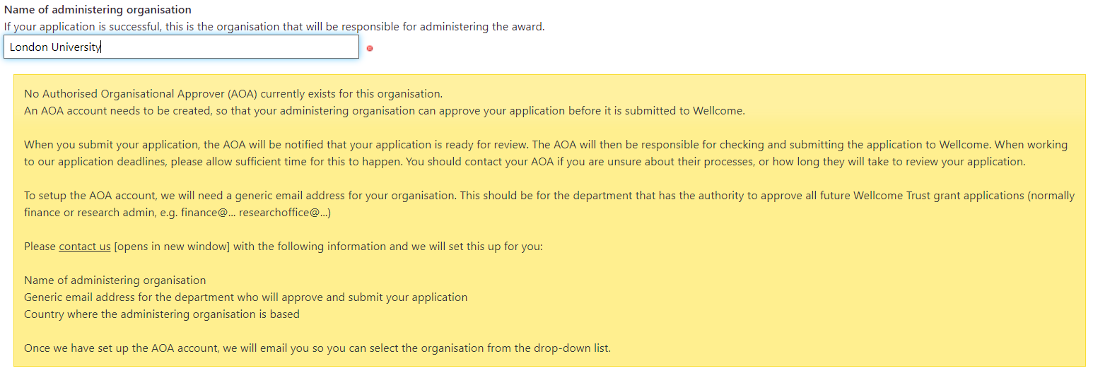
Notes:
This message will appear in the application form. They will need to provide the requested information to set up an AOA before being able to submit the application.

Slide 8
General Tips
Lead Applicant
AOA
Wellcome
Notes:
Here you can see the journey of a full application. Once the applicant clicks submit it is sent to the AOA. They can then look through the application and send it back to the applicant if they feel any changes need to be made. Once they are happy with the application they can approve it and the application will be sent to Wellcome. The AOA approval must be done by the full application deadline listed on the scheme page.

Slide 9
General Tips
Re-applying?
Unsuccessful Preliminary application – No need to contact us
Unsuccessful Full application – Contact us before applying
Notes:
If an applicant has previously been unsuccessful in applying at the preliminary stage, the applicant does not have to contact Wellcome before submitting another application. If they were unsuccessful at the full application stage they should contact the individual that informed them of the decision to discuss the application before resubmitting.

Slide 10
General Tips
Sponsor
Head of Department or similar
Able to guarantee applicant will be given the resources to complete the fellowship
Notes:
The sponsor for the application would be the Head of Department or similar at the host organisation. They will need to guarantee the applicant is given the resources to complete the fellowship.

Slide 11
General Tips
Supervisor
Responsible for day-to-day supervision
Agreed upon before submitting an application
Notes:
Supervisors are responsible for the day to day guidance during the fellowship. They should have an ongoing research programme and a strong track record in mentorship. You will need have a supervisor in place before submitting your application.

Slide 12
General Tips
Collaborator
Someone who provides their expertises
Does not have to be at the host organisation
Notes:
A collaborator provides subject related expertise, support or materials, but are not involved in the day-to-day running of the research. They do not have to be based at the applicant’s host organisation.

Slide 13
General Tips
Salary Support
Request salary which is appropriate to career stage
Basic starting salary should be net yearly salary
Total salary should include add-ons
A clear explanation of add-ons and salary scale justification should be provided
Notes:
When adding salary costs to the application it is important to provide salaries that are appropriate to the individual’s career stage. The basic starting salary should be the applicant’s net yearly salary. The total salary should include add-ons such as tax and pension. The application form should include a clear explanation of what add-ons the applicant receives and why the salary is appropriate to their career stage.

Slide 14
General Tips
Salary support
International Masters Fellowship | International Training Fellowship | International Intermediate Fellowship
Lead applicant salary | Lead applicant salary Staff salary covered in exceptional circumstances only | Lead applicant salary One research assistant or technician, more if doing fieldwork or clinical studies
Remember to check the scheme page for full details
Notes:
Here you can see the types of salary support the 3 international schemes provide. It is generally only the Intermediate that allows salary support for staff. It is important to read the ‘what we offer’ section of the scheme pages before adding any costs.

Slide 15
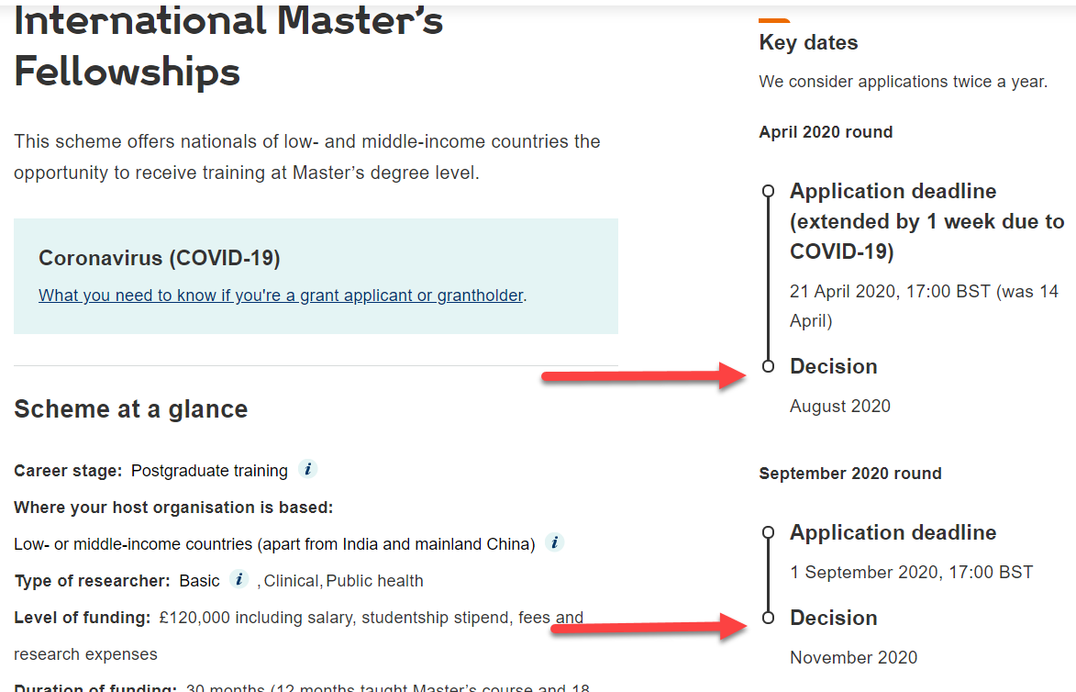
International Masters Fellowship
Masters course must be taught and related to an appropriate health discipline
Bear in mind the decision dates when applying
Notes:
It is important to remember that the masters course must be in an appropriate health discipline.
Also keep in mind when the decisions will be made for the fellowship and when the applicant’s master course starts. For example applications to the September 2020 deadline can’t fund a master course starting in September 2020 as the decisions aren’t until November 2020.

Slide 16
International Masters Fellowship
Already have a Masters?
Contact us first – grantenquiries@wellcome.ac.uk
Notes:
If the applicant already has a masters they will need to contact us before applying. We will need to determine whether they would still be eligible to apply.

Slide 17
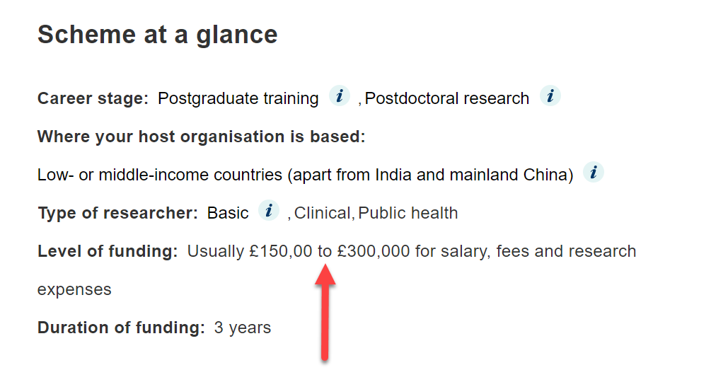
International Training Fellowship
Check the funding level
Notes:
Before applying make sure to check the funding level for the fellowship and that the costs are at the right level. Information on what can be requested can be found on the scheme page

Slide 18
International Training Fellowship
Looking for PhD funding?
The PhD must be in in a science discipline relevant to health
Notes:
If the applicant is applying for PhD funding the PhD must be in a science discipline relevant to health

Slide 19
International Training Fellowship
Looking for PhD funding?
Should be done in the country the applicants is doing the research
Can’t do it in that country?
Contact us first to discuss
Notes:
The PhD should also be done close to the host organisation. If this is not possible the applicant will need to contact us before submitting their application

Slide 20
International Training Fellowship
Looking for PhD funding?
Should not of already started the PhD before a decision has been made on your application
Notes:
If the applicant is looking to fund a PhD with the fellowship they can not have started their PhD. Applicants are able to apply in the final year of their PhD

Slide 21
Questions
Can a full-time professor at an institution serve as a host, even though he may not necessarily be the director?
The sponsor does need to be the Head of Department or equivalent as we want to be sure that the spaces and resources can be guaranteed for the duration of the fellowship and that the fellow will be employed by the host institution. A full-time professor can act as the day to day supervisor on an International Training Fellowship and International Master’s Fellowship.

Slide 22
Questions
When submitting a different research question for an intermediate, a couple of years after a failed full application do I need to contact the grants office?
Yes. If you have previously submitted a full application, then you will need to contact us first before you apply.

Slide 23
Questions
You said no staff costs other than the applicant. This makes field research almost impossible!
For the International Master’s Fellowship, we don’t support research assistance on this fellowship. The scope of your research should be appropriate for you to be able to carry out any fieldwork without the need of research assistance. Alternatively, you could nest your study within existing fieldwork/clinical work where staff are being paid for by your host organisation.

Slide 24
Questions
For the International Training Fellowship, we wouldn’t typically expect to see other staff costs (e.g. research assistants or research technicians) as this stage fellowship is aimed at individuals who still need guided periods of training and should not yet be in a position to supervise staff. However, if you will be doing fieldwork or clinical work we will consider in exceptional circumstances requests for additional staff. You must provide good justification for why they are necessary and you are unable to complete the work yourself.

Slide 25
Questions
For the International Intermediate Fellowship, we support requests for full-time research assistance. This would typically be one research assistant or research technician. We will consider request for additional support if you will be conducting fieldwork or clinical studies.

Slide 26
Questions
Are pre-prints considered equal to peer-reviewed paper?
When assessing your track record, we will consider pre-prints, peer reviewed publications and other outputs such as patents, datasets, policy changes etc

Slide 27
Questions
Will you be able to provide feedbacks to the unsuccessful applicants?
Due to the volume of preliminary applications we receive we are unable to provide feedback at this stage. If you are invited to submit a full application, then you will receive feedback and for some fellowships the peer review comments.

Slide 28
Questions
How do I begin the application for both the masters fellowship or training fellowship?
Please visit our website www.wellcome.org for more information on these schemes and how to apply.
International Master’s Fellowship: https://wellcome.org/grant-funding/schemes/international-masters-fellowships
International Training Fellowship: https://wellcome.org/grant-funding/schemes/international-training-fellowships
International Intermediate Fellowship: https://wellcome.org/grant-funding/schemes/international-intermediate-fellowships

Slide 29
Questions
Can a sponsor also be a supervisor?
Yes. Where a sponsor has the appropriate experience to provide day to day supervision on the research proposal they can act as both a sponsor and a supervisor.

Slide 30
Questions
Do references (bibliography) counts for the 1,400 words of the project?
References and figure legends do not count towards the 1,400 word for your research proposal.

Slide 31
Questions
How do I invite the sponsors to add their details?
For more information on using Grant Tracker to submit your application please go to the following website: https://wellcome.org/grant-funding/guidance/how-use-grant-tracker

Slide 32
Questions
How many sponsors should one have
For the International Master’s Fellowship and the International Training Fellowship you are only required to have one sponsor, who should be the Head of Department (or equivalent) at your host organisation. If you are spending periods of training in other research locations, then you should identify an appropriate supervisor who will supervise you day to day for those periods of training.

Slide 33
Questions
For the International Intermediate Fellowship you should have one sponsor who will be the Head of Department (or equivalent) at your host organisation. If you will be spending more than 4 months (cumulative) outside your host organisation you should also have a sponsor from that research location who can guarantee access to spaces and resources.

Slide 34
Thanks!
Contact
grantenquires@wellcome.ac.uk

