Slide 1

How Africa thinks & feels about vaccines, science and health
Wellcome Global Monitor 2018
@WellcomeTrust
#wmonitor

Slide 2






Overview
144 40 140k+
Countries
African Countries
People Interviewed

Slide 3
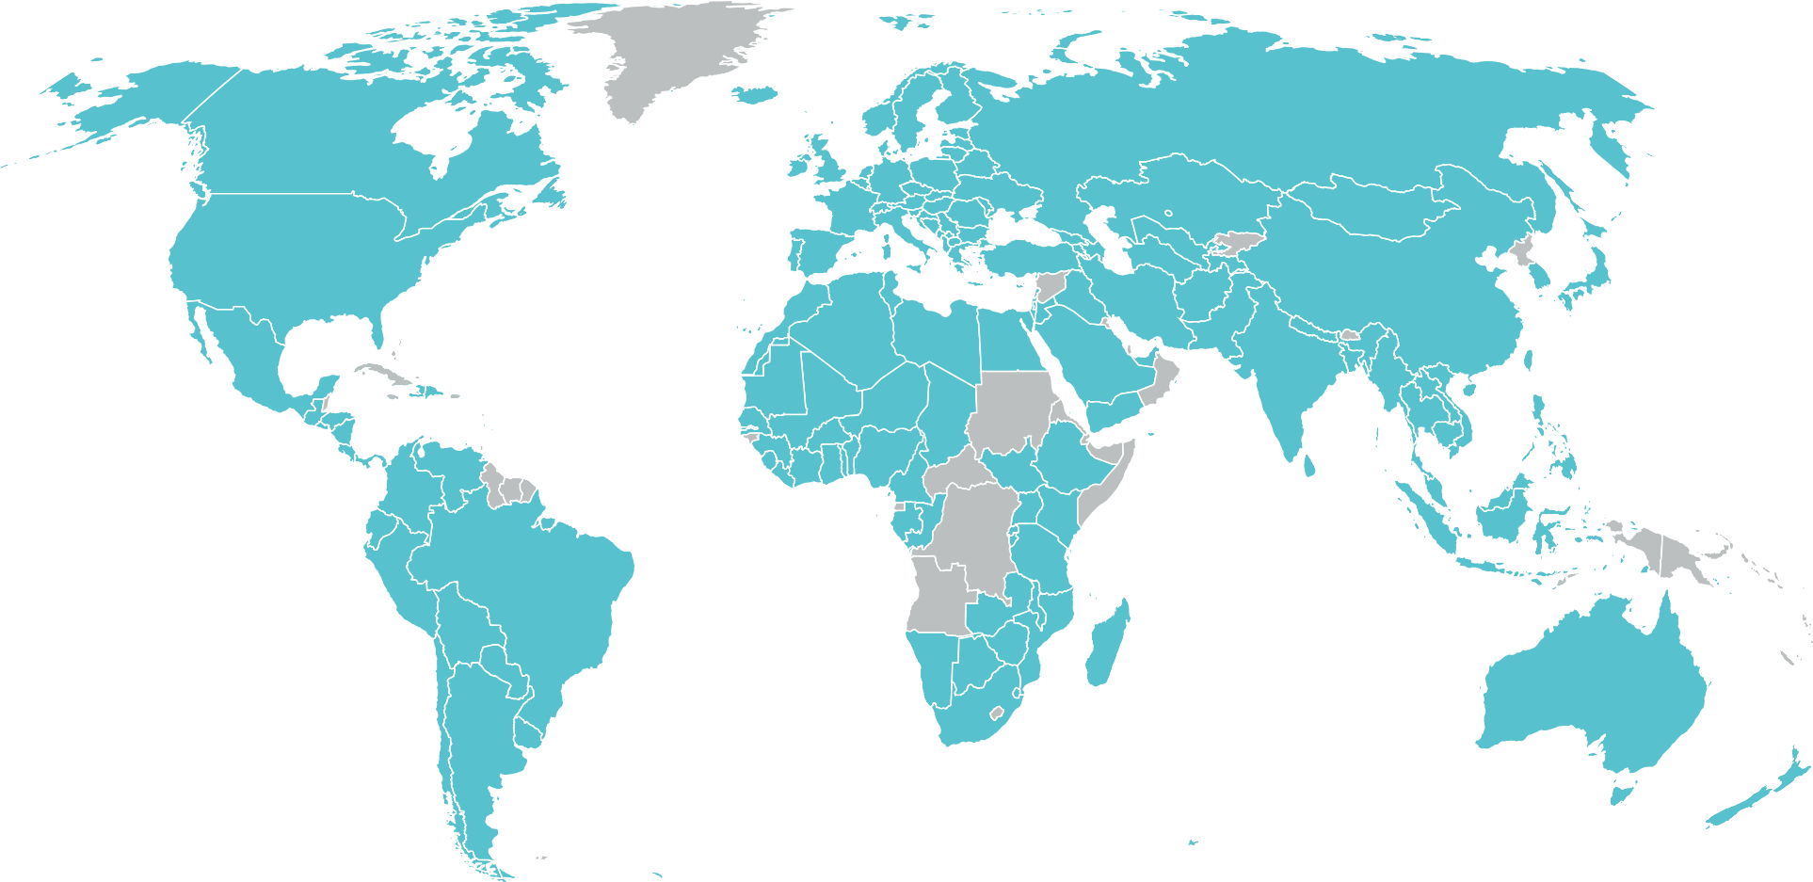
144 Countries
Why were these countries chosen?
Gallup World Poll covers 99% of the world’s adult population and aims to obtain maximum coverage. Small island nations are omitted, due to high costs of implementation and little academic/policy interest. Gallup does not avoid countries due to war and has fielded in countries including Libya, Iraq and Yemen, when they are confident that they can collect reliable data that does not put interviewers at risk. But there are some nations – like North Korea – that do not give governmental permission to conduct survey research.

Slide 4
Key findings in Africa

Slide 5
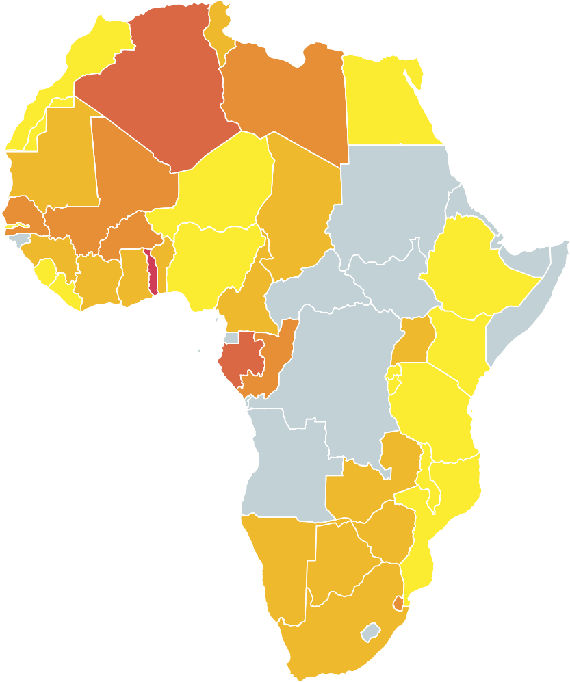

In Africa, 87% of people agree that vaccines are safe
Share of people who agree that vaccines are safe (%)
Most % agree
Egypt | 97%
Ethiopia | 96%
Liberia | 96%
Tanzania | 96%
Rwanda | 94%
Why were these countries chosen?
Gallup World Poll covers 99% of the world’s adult population and aims to obtain maximum coverage. Small island nations are omitted, due to high costs of implementation and little academic/policy interest. Gallup does not avoid countries due to war and has fielded in countries including Libya, Iraq and Yemen, when they are confident that they can collect reliable data that does not put interviewers at risk. But there are some nations – like North Korea – that do not give governmental permission to conduct survey research.
Source: Wellcome Global Monitor, part of the Gallup World Poll 2018
Least % agree
Mali | 66%
Algeria | 63%
Mauritius | 63%
Gabon | 63%
Togo | 51%
50-60
60-70
70-80
80-90
90-100
No data

Slide 6
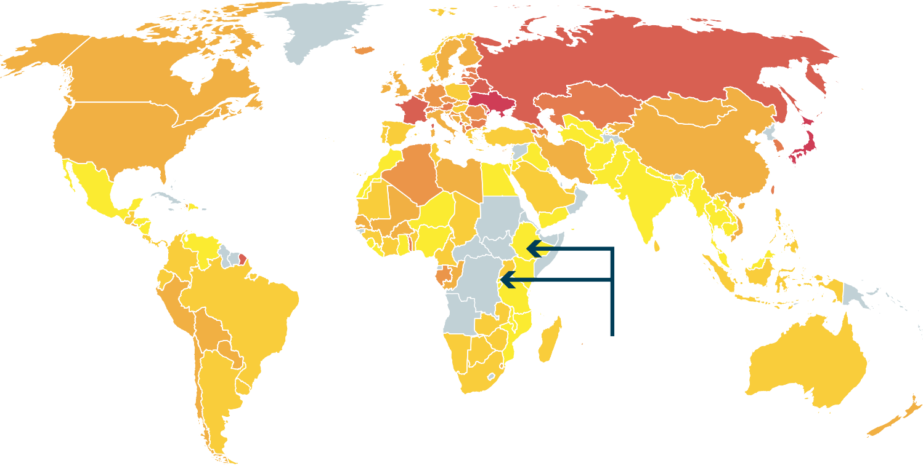
People in Africa are significantly more likely to agree that
vaccines are safe (87%) compared to the rest of the world, excluding Africa (78%)
Share of people who agree that vaccines are safe (%)
30-40
40-50
50-60
60-70
70-80
80-90
90-100
No data
The highest trust in vaccines comes in developing
countries like Ethiopia and Rwanda
Source: Wellcome Global Monitor, part of the Gallup World Poll 2018

Slide 7
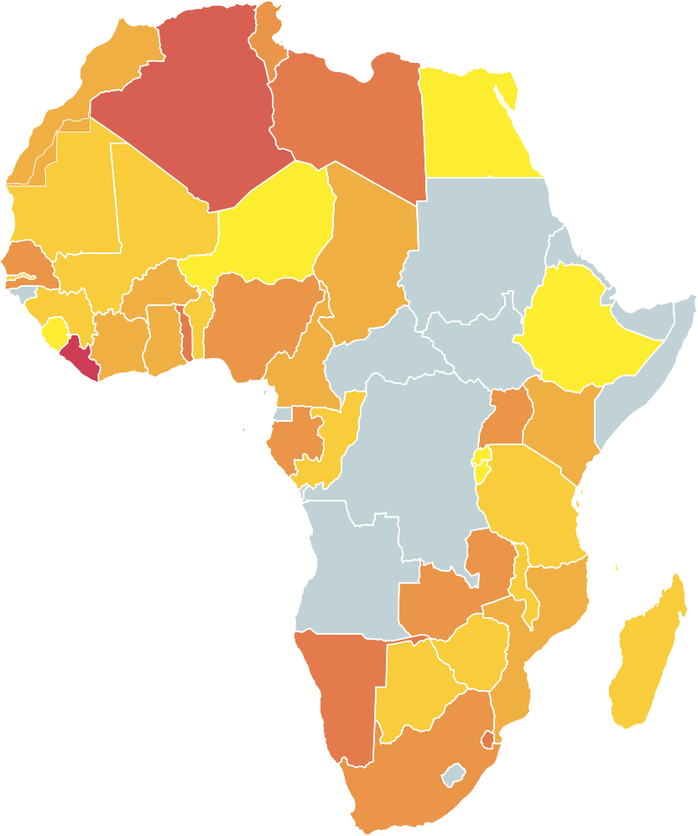
In Africa, 86% of people agree that vaccines are effective
Share of people who agree that vaccines are effective (%)
Most % agree
Rwanda | 99%
Ethiopia | 97%
Egypt | 96%
Malawi | 94%
Comoros | 93%
65-70
70-75
75-80
80-85
85-90
90-95
95-100
No data
Why were these countries chosen?
Gallup World Poll covers 99% of the world’s adult population and aims to obtain maximum coverage. Small island nations are omitted, due to high costs of implementation and little academic/policy interest. Gallup does not avoid countries due to war and has fielded in countries including Libya, Iraq and Yemen, when they are confident that they can collect reliable data that does not put interviewers at risk. But there are some nations – like North Korea – that do not give governmental permission to conduct survey research.
Source: Wellcome Global Monitor, part of the Gallup World Poll 2018
Least % agree
Morocco | 76%
Libya | 74%
Togo | 70%
Liberia | 68%
Algeria | 64%

Slide 8
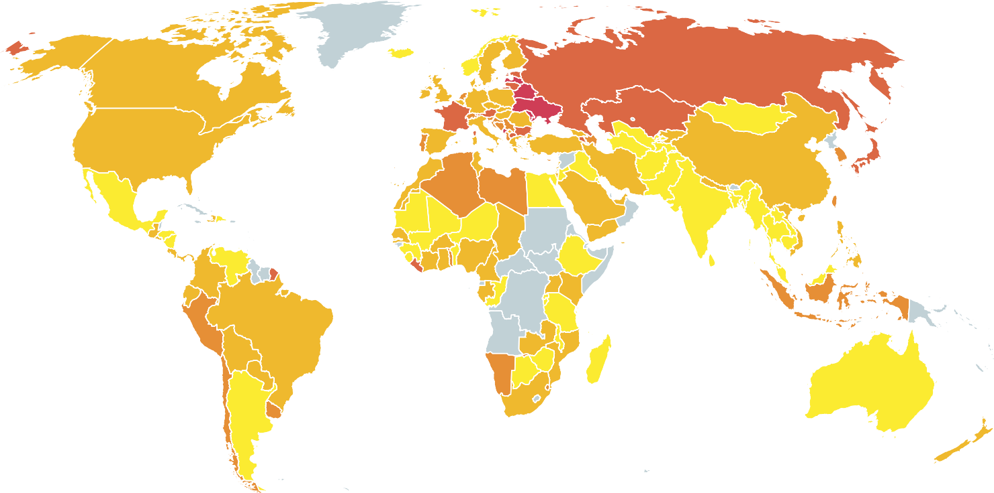
Share of people who agree that vaccines are effective (%)
People in Africa are significantly more likely to agree that vaccines are effective (86%) compared to the rest of the world, excluding Africa (83%)
50-60
60-70
70-80
80-90
90-100
No data
Source: Wellcome Global Monitor, part of the Gallup World Poll 2018

Slide 9
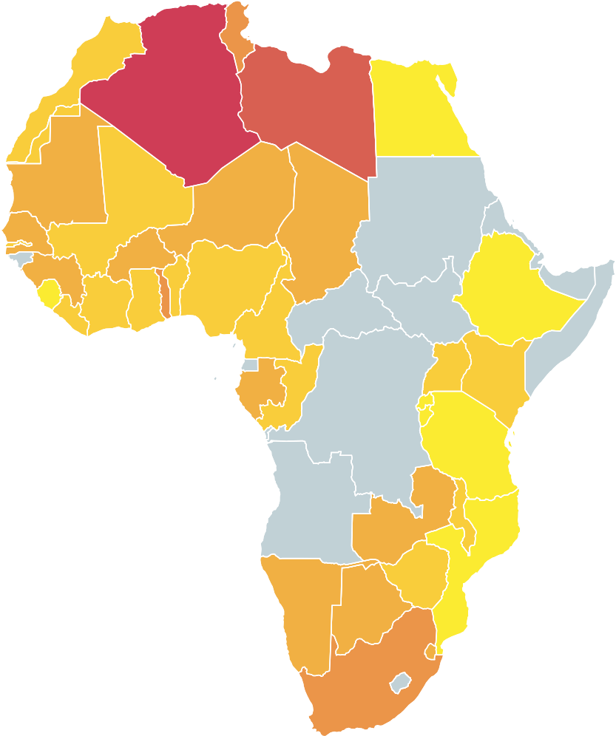
In Africa, 96% of people agree that vaccines are important for children to have
Share of people who agree that it is important for children to be vaccinated (%)
Most % agree
Ethiopia | 100%
Egypt | 99%
Tanzania | 99%
Rwanda | 98%
Burundi | 98%
86-88
88-90
90-92
92-94
94-96
96-98
98-100
No data
Why were these countries chosen?
Gallup World Poll covers 99% of the world’s adult population and aims to obtain maximum coverage. Small island nations are omitted, due to high costs of implementation and little academic/policy interest. Gallup does not avoid countries due to war and has fielded in countries including Libya, Iraq and Yemen, when they are confident that they can collect reliable data that does not put interviewers at risk. But there are some nations – like North Korea – that do not give governmental permission to conduct survey research.
Source: Wellcome Global Monitor, part of the Gallup World Poll 2018
Least % agree
Guinea | 91%
Togo | 91%
Mauritania | 91%
Libya | 87%
Algeria | 84%

Slide 10
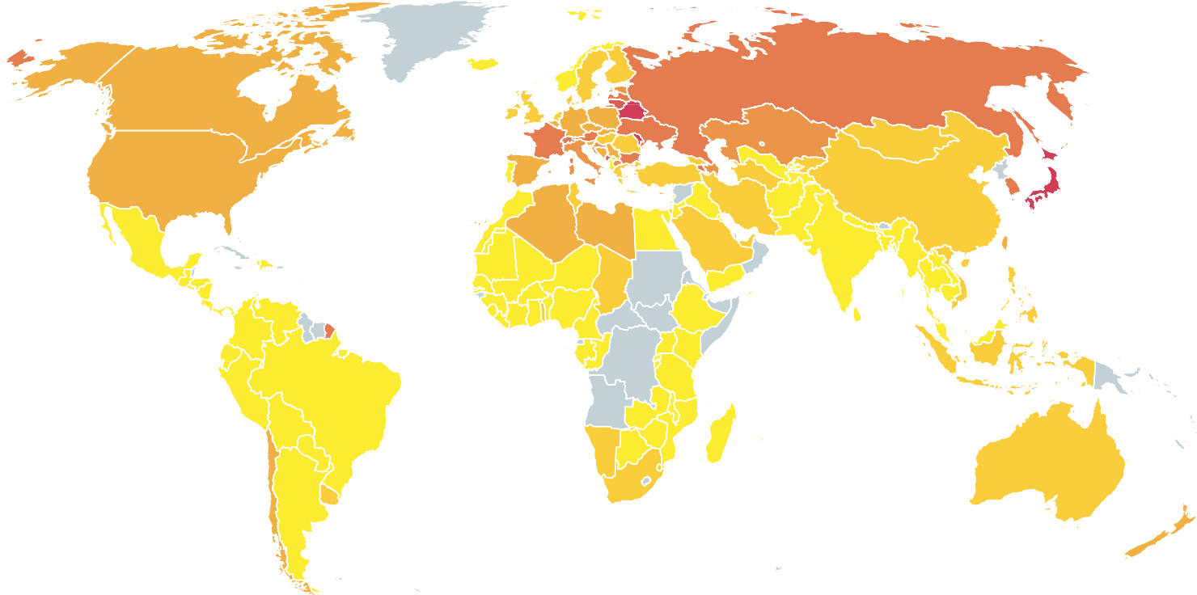
Share of people who agree that it is important for children to be vaccinated (%)
People in Africa are more likely to agree that vaccines are important for children to have (96%) compared to the rest of the world, excluding Africa (92%)
65-70
70-75
75-80
80-85
85-90
90-95
95-100
No data
Source: Wellcome Global Monitor, part of the Gallup World Poll 2018

Slide 11
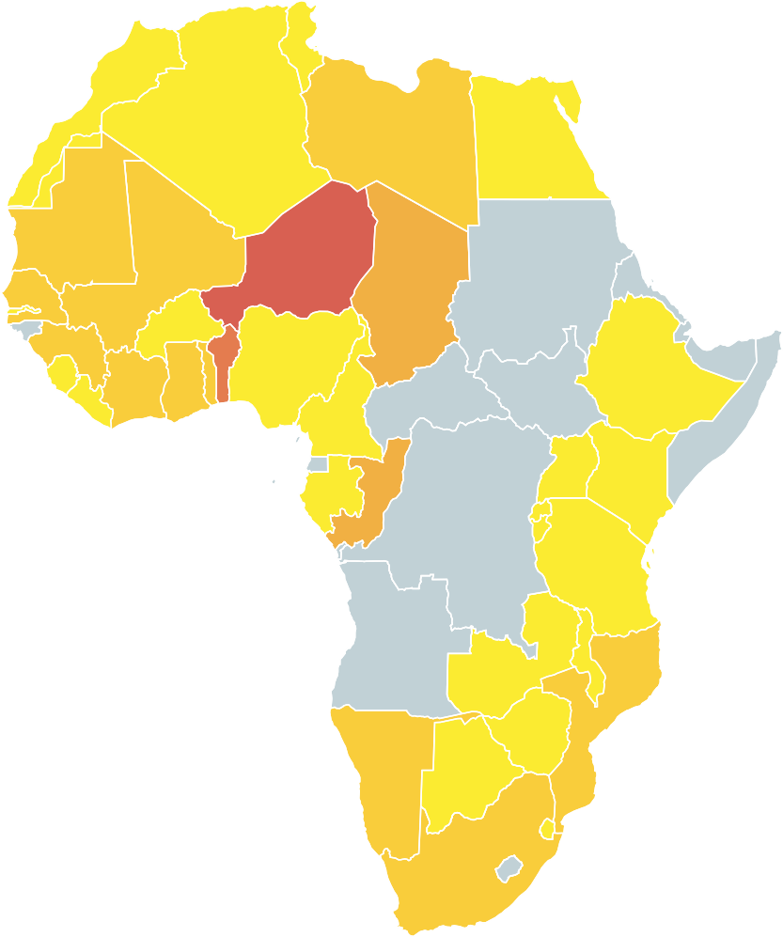
In Africa, 95% of parents say they have vaccinated their children
Share of parents who say their children have been vaccinated (%)
Most % agree
Egypt | 100%
Rwanda | 100%
Morocco | 99%
Malawi | 98%
Gabon | 98%
65-70
70-75
75-80
80-85
85-90
90-95
95-100
No data
Why were these countries chosen?
Gallup World Poll covers 99% of the world’s adult population and aims to obtain maximum coverage. Small island nations are omitted, due to high costs of implementation and little academic/policy interest. Gallup does not avoid countries due to war and has fielded in countries including Libya, Iraq and Yemen, when they are confident that they can collect reliable data that does not put interviewers at risk. But there are some nations – like North Korea – that do not give governmental permission to conduct survey research.
Source: Wellcome Global Monitor, part of the Gallup World Poll 2018
Least % agree
Ivory Coast | 88%
Mauritius | 88%
Republic of the Congo | 85%
Benin | 73%
Niger | 69%

Slide 12
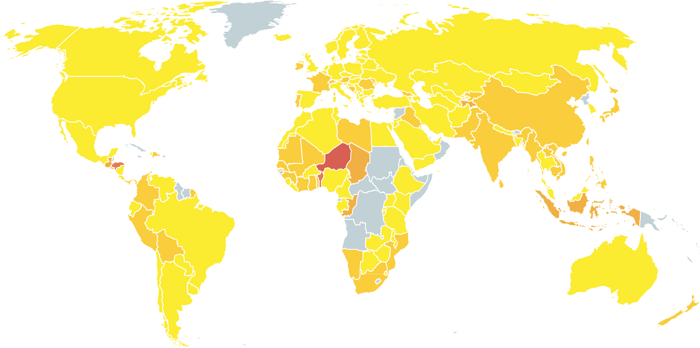
Share of parents who say their children have been vaccinated (%)
Parents in Africa are significantly more likely (95%) to say they have vaccinated their children, compared to the rest of the world, excluding Africa (92%)
65-70
70-75
75-80
80-85
85-90
90-95
95-100
No data
Source: Wellcome Global Monitor, part of the Gallup World Poll 2018

Slide 13
Key relationships

Slide 14
In Africa, if you believe science benefits most people in society...
... you’re five times as likely to have high trust in scientists...
... than if you believe it benefits very few

Slide 15
In Africa, about six in ten people feel that science benefits them, but there is wide variation across regions
Response Type
Yes
Eastern Africa
69%
22%
9%
No
Don’t know/ refused
Central Africa
61%
27%
12%
North Africa
49%
34%
17%
Southern Africa
55%
37%
9%
Western Africa
70%
19%
10%
Percentage of people who answered ‘yes’, ‘no’ or ‘don’t know/refused’.
In general, do you think the work that scientists do benefits people like you in this country?

Slide 16
In Africa, a third of people believe that science benefits most people in their country
Think scientists’ work benefits people in this country
Most
Eastern Africa
37%
31%
21%
Central Africa
31%
26%
28%
Some Very few
North Africa
22%
40%
23%
Southern Africa
24%
29%
36%
Western Africa
38%
34%
16%
Percentage of people who answered ‘most’, ‘some’ or ‘very few’.
Do you think the work that scientists do benefits most, some or very few people in this country?

Slide 17
In Africa, how much a country invests in R&D appears to relate to trust in vaccine safety

Slide 18
Share of people who agree that vaccines are safe, vs share of country GDP that is spent on research and development*
In Africa, there is a correlation between people who agree that vaccines are safe and share of country GDP invested in R&D
SHARE WHO AGREE THAT VACCINES ARE SAFE (%)
100
Egypt Ethiopia
90
Tanzania
Morocco
The Gambia Madagascar
^{Nigeria} Mozambique
Botswana
Kenya
Chad
Namibia
South Africa
80
Uganda
Tunisia
Zambia
Senegal
Algeria
Mauritius
Mali
70
ina Faso
Burk
60
Togo
50
0
0.2 0.4
0.6 0.8
SHARE OF GDP SPENT ON R&D (%)
Country Trend
*After controlling Gross Domestic Product (GDP) per capita in Purchasing Power Parity (PPP)
Source: Wellcome Global Monitor, part of the Gallup World Poll 2018

Slide 19
Share of people who agree that vaccines are safe (%), vs share of country GDP that is spent on research and development*
In Africa, there is a correlation between people who agree that vaccines are safe and share of country GDP invested in R&D
SHARE WHO AGREE THAT VACCINES ARE SAFE (%)
100
75
50
25
0
0-0.3
0.3-0.6
0.6-0.9
SHARE OF GDP SPENT ON R&D (%)
*After controlling Gross Domestic Product (GDP) per capita in Purchasing Power Parity (PPP)
Source: Wellcome Global Monitor, part of the Gallup World Poll 2018

Slide 20
Trust in scientists appears to be linked
to knowledge of science

Slide 21
Factors which may influence trust in scientists globally
TRUST IN SCIENTISTS INDEX 3.05 3.10 3.15 3.20
2.75
2.80
2.85
2.90
2.95
3.00
No formal education
Science at primary only
SCIENCE
EDUCATION
Up to secondary
Up to college
Wellcome Global Monitor Trust in Scientists Index.

Slide 22
In all regions of Africa men believe they know more than women about science
PERCENTAGE POINT DIFFERENCE IN ANSWERING ‘A LOT’ OR ‘SOME’ BETWEEN MEN AND WOMEN
16
14%
14
13%
12%
12%
12
11%
10
8
7%
6
4
2
0
World
Eastern Africa
Western Africa
Central Africa
Southern Africa
North Africa
Related survey question: ‘How much do you, personally, know about science? Do you know a lot, some, not much, or nothing at all?’

Slide 23
In Africa, across all levels of education, women are significantly less likely than men to say they know ‘some’ or ‘a lot’ about science
% OF PEOPLE WHO ANSWERED, ‘A LOT’ OR ‘SOME’ ACROSS ALL COUNTRIES
90
79%
81%
80
70
60
57%
51%
50
40
33%
30
20
20%
10
0
0-8 years
Men
9-15 years
16+ years
Women
LEVEL OF SCIENCE EDUCATION IN YEARS
Related survey question: ‘How much do you, personally, know about science? Do you know a lot, some, not much, or nothing at all?’

Slide 24
Trust in vaccines appears to link to trust in the people &
institutions behind them

Slide 25
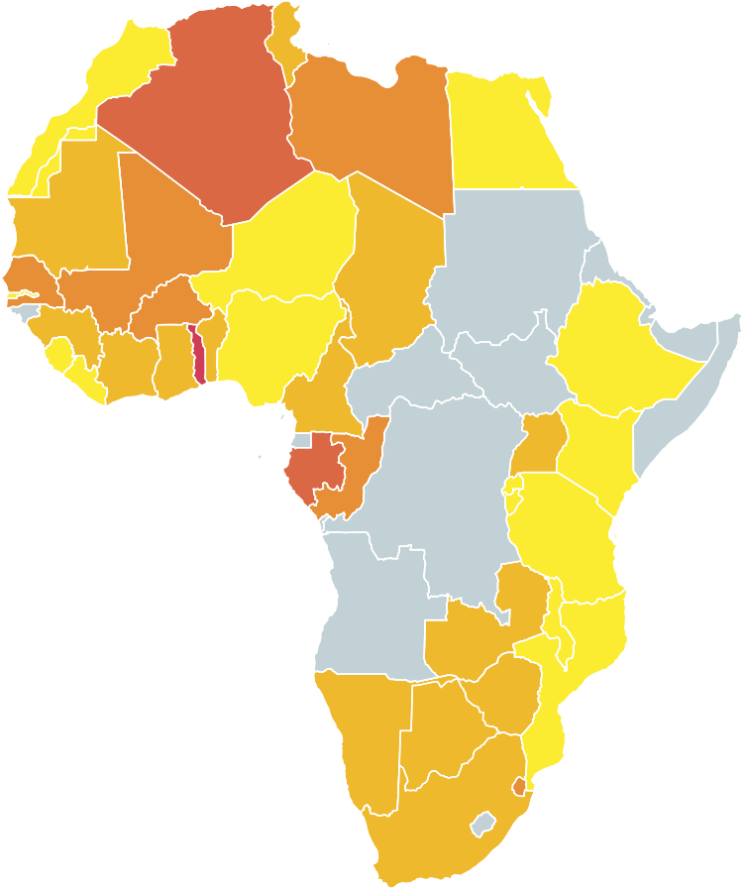
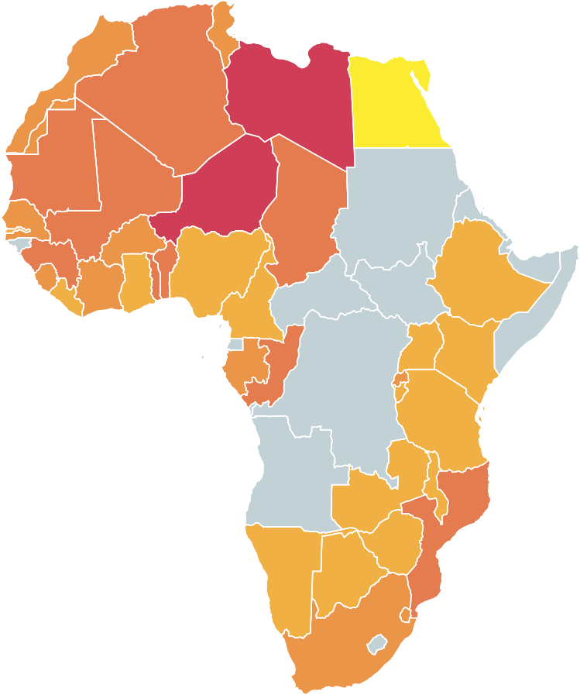
Share of people who agree that vaccines are safe (%)
Share of people who would trust a doctor or nurse the most to give them medical or health advice (%)
40-50
50-60
60-70
70-80
80-90
90-95
95-100
No data
50-60
60-70
70-80
80-90
90-100
No data
Source: Wellcome Global Monitor, part of the Gallup World Poll 2018

Slide 26
Confidence in institutions is also a strong predictor of trust in scientists globally
TRUST IN SCIENTISTS INDEX 3.05 3.10 3.15 3.20
2.75
2.80
2.85
2.90
2.95
3.00
 | No
CONFIDENCE
IN MILITARY
 | Yes
 | No
CONFIDENCE
IN NATIONAL
GOVERNMENT
 | Yes
Wellcome Global Monitor Trust in Scientists Index.

Slide 27
In Africa, trust in vaccines appears to link to trust in scientists
% WHO AGREE THAT VACCINES ARE SAFE
100
94%
90
88%
80
77%
70
60
50
40
30
20
10
0
High trust
Medium trust
Low trust

Slide 28

The Trust Ecosystem
Perceived benefits of science
Wellcome Global Monitor demonstrates that all of these factors relate to trust in vaccines, but we do not know which single factor would cause trust in vaccines to improve.
This is where further research is required on a local level.
Trust in institutions
Trust in scientists
Trust in Vaccines
Investment in R&D
Knowledge of science

Slide 29
Sign up for findings and updates at
wellcome.ac.uk/monitor #wmonitor

